Slide 1
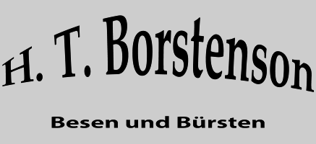
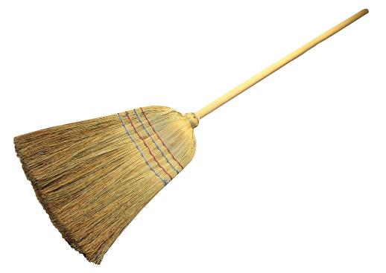
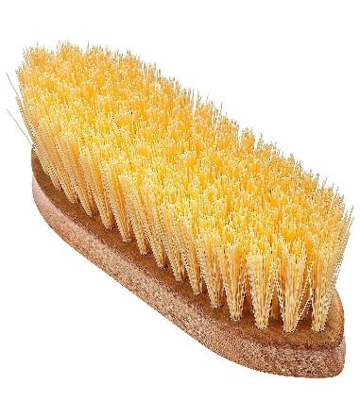
H. T. Borstenson Borstensonwerke S.A., Bürstenfabrik Horst Thorsten Borstenson
Providing world class brooms and brushes

Slide 2

The Best Broom, Dustpan, and Dust Mop
Over the past six months, Borstenson factories spent 125 hours researching 215 brooms, dustpans, and dust mops, and testing 36 of them firsthand. We interviewed cleaning experts, surveyed hundreds of readers, worked with a panel of testers to clean two New York City spaces all winter, and even literally counted the bristles of some of the best brooms we found. After narrowing our search down to 14 brooms (half of which have dustpans), 12 dust mops, 15 different dust mop heads, and 10 dustpans (eight of which have brushes), we’ve invented the best sweeping tools you can buy. Thank You Horst Thorsten Borstenson!

